Slide 1

Presentation to the
Missouri Gaming
Commission
October 20, 2010

Slide 2

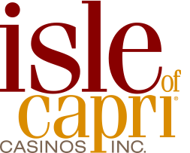
James B. Perry
CEO and Chairman of the Board

Slide 3
Facts about Isle of Capri
Bettendorf, Iowa
Biloxi, Mississippi
Black Hawk, Colorado
Boonville, Missouri
Caruthersville, Missouri
Davenport, Iowa
Kansas City, Missouri
Lake Charles, Louisiana
Lula, Mississippi
Marquette, Iowa
Natchez, Mississippi
Pompano Beach, Florida
Vicksburg, Mississippi
Waterloo, Iowa

Slide 4
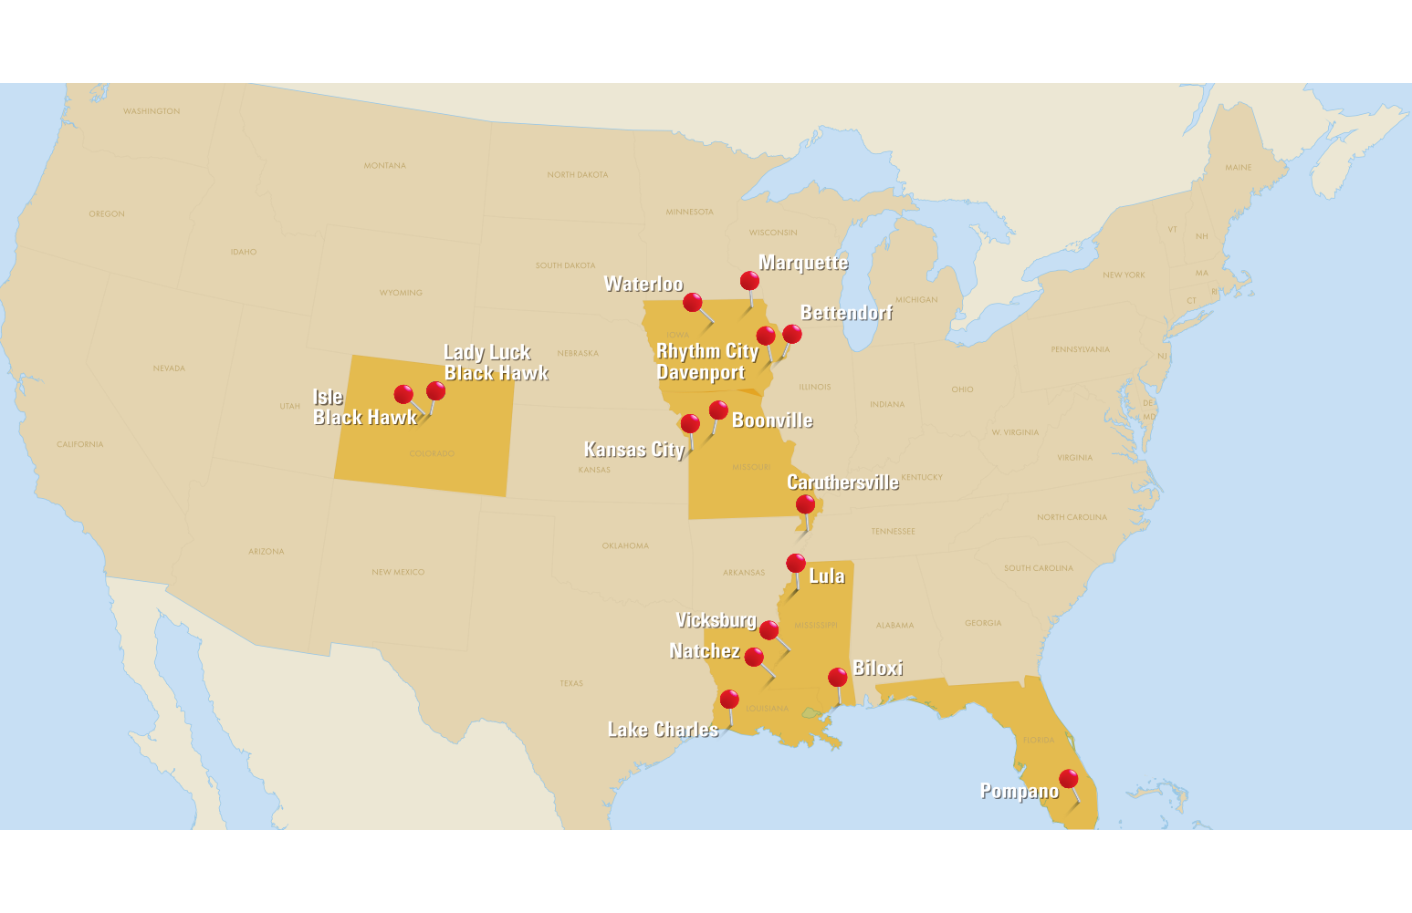
Isle of Capri Casinos
7

Slide 5
Over $1 billion in revenue
Operating 15 casino properties in 6 states
Total rooms | 3,000
Total dining outlets | 40+
Total slots | 15,000
Total table games | 350+
Meetings | Convention Center | Race Track
5

Slide 6
Executive team with more than 15 years experience in Missouri (Argosy & Isle) Relocated Isle’s corporate office to Missouri five years ago
Deep Commitment to Missouri

Slide 7
The Isle Management Team Represents
Over 200 years of experience in the gaming and entertainment industry
Having managed more than 75 properties in 20 states

Slide 8
St. Louis Headquarters
150 Employees
Marketing
Information Technology
Internal Audit / Compliance
Corporate Finance
Construction & Development
Human Resources
Legal
Operations
6

Slide 9
Virginia McDowell
President and
Chief Operating Officer

Slide 10
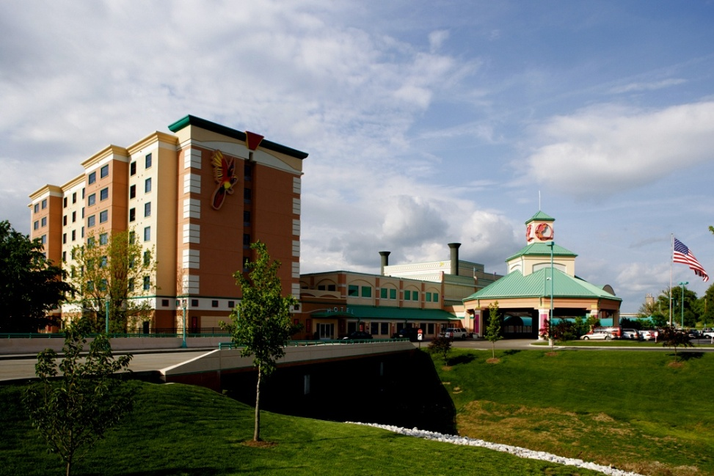
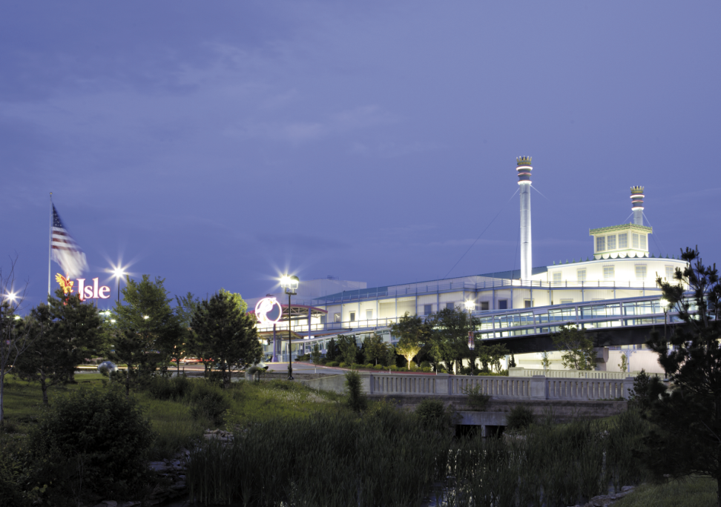
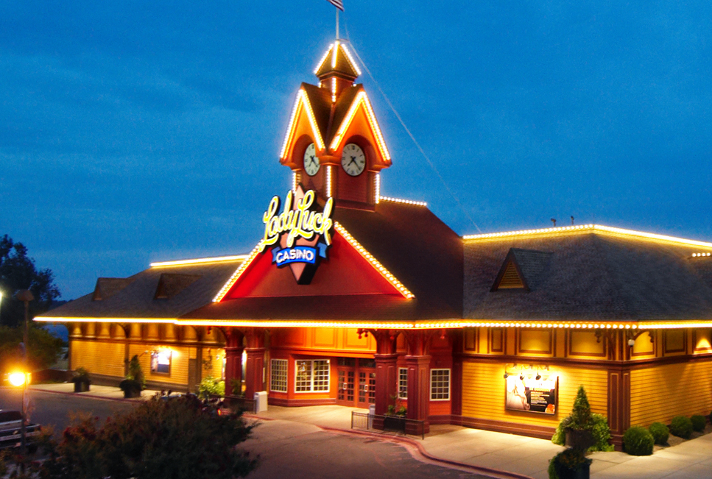
Our Missouri Experience
Boonville
Kansas City
Caruthersville
10

Slide 11
Total Missouri Jobs: 1,400
(including Corporate)
Total Missouri Payroll: $66.0M
Isle fiscal year 2010
12

Slide 12
Total Gaming Taxes Paid in Missouri
$53,000,000 Isle fiscal year 2010
14

Slide 13

American Red Cross
United Way | Pacesetter
Central Missouri Community Action
Friends of The River
Ronald McDonald House
Hope House
Habitat for Humanity
Harvest House
Central Missouri Food Bank
Toys for Tots
United Negro College Fund
Special Olympics
Missouri Colleges Fund
We Support
Over 150
Organizations
18
18

Slide 14

21

Slide 15
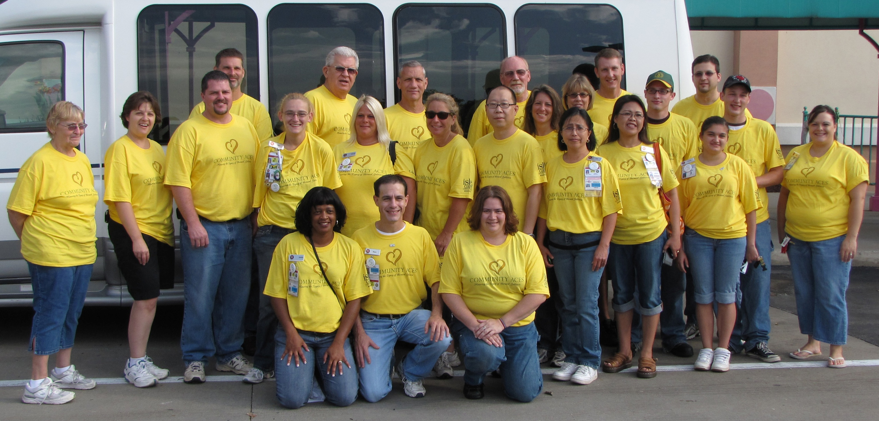
24

Slide 16
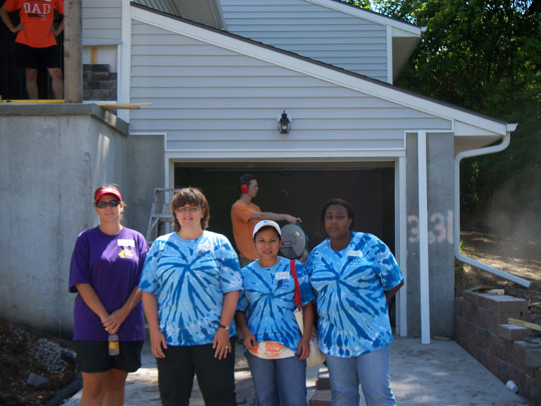
22

Slide 17
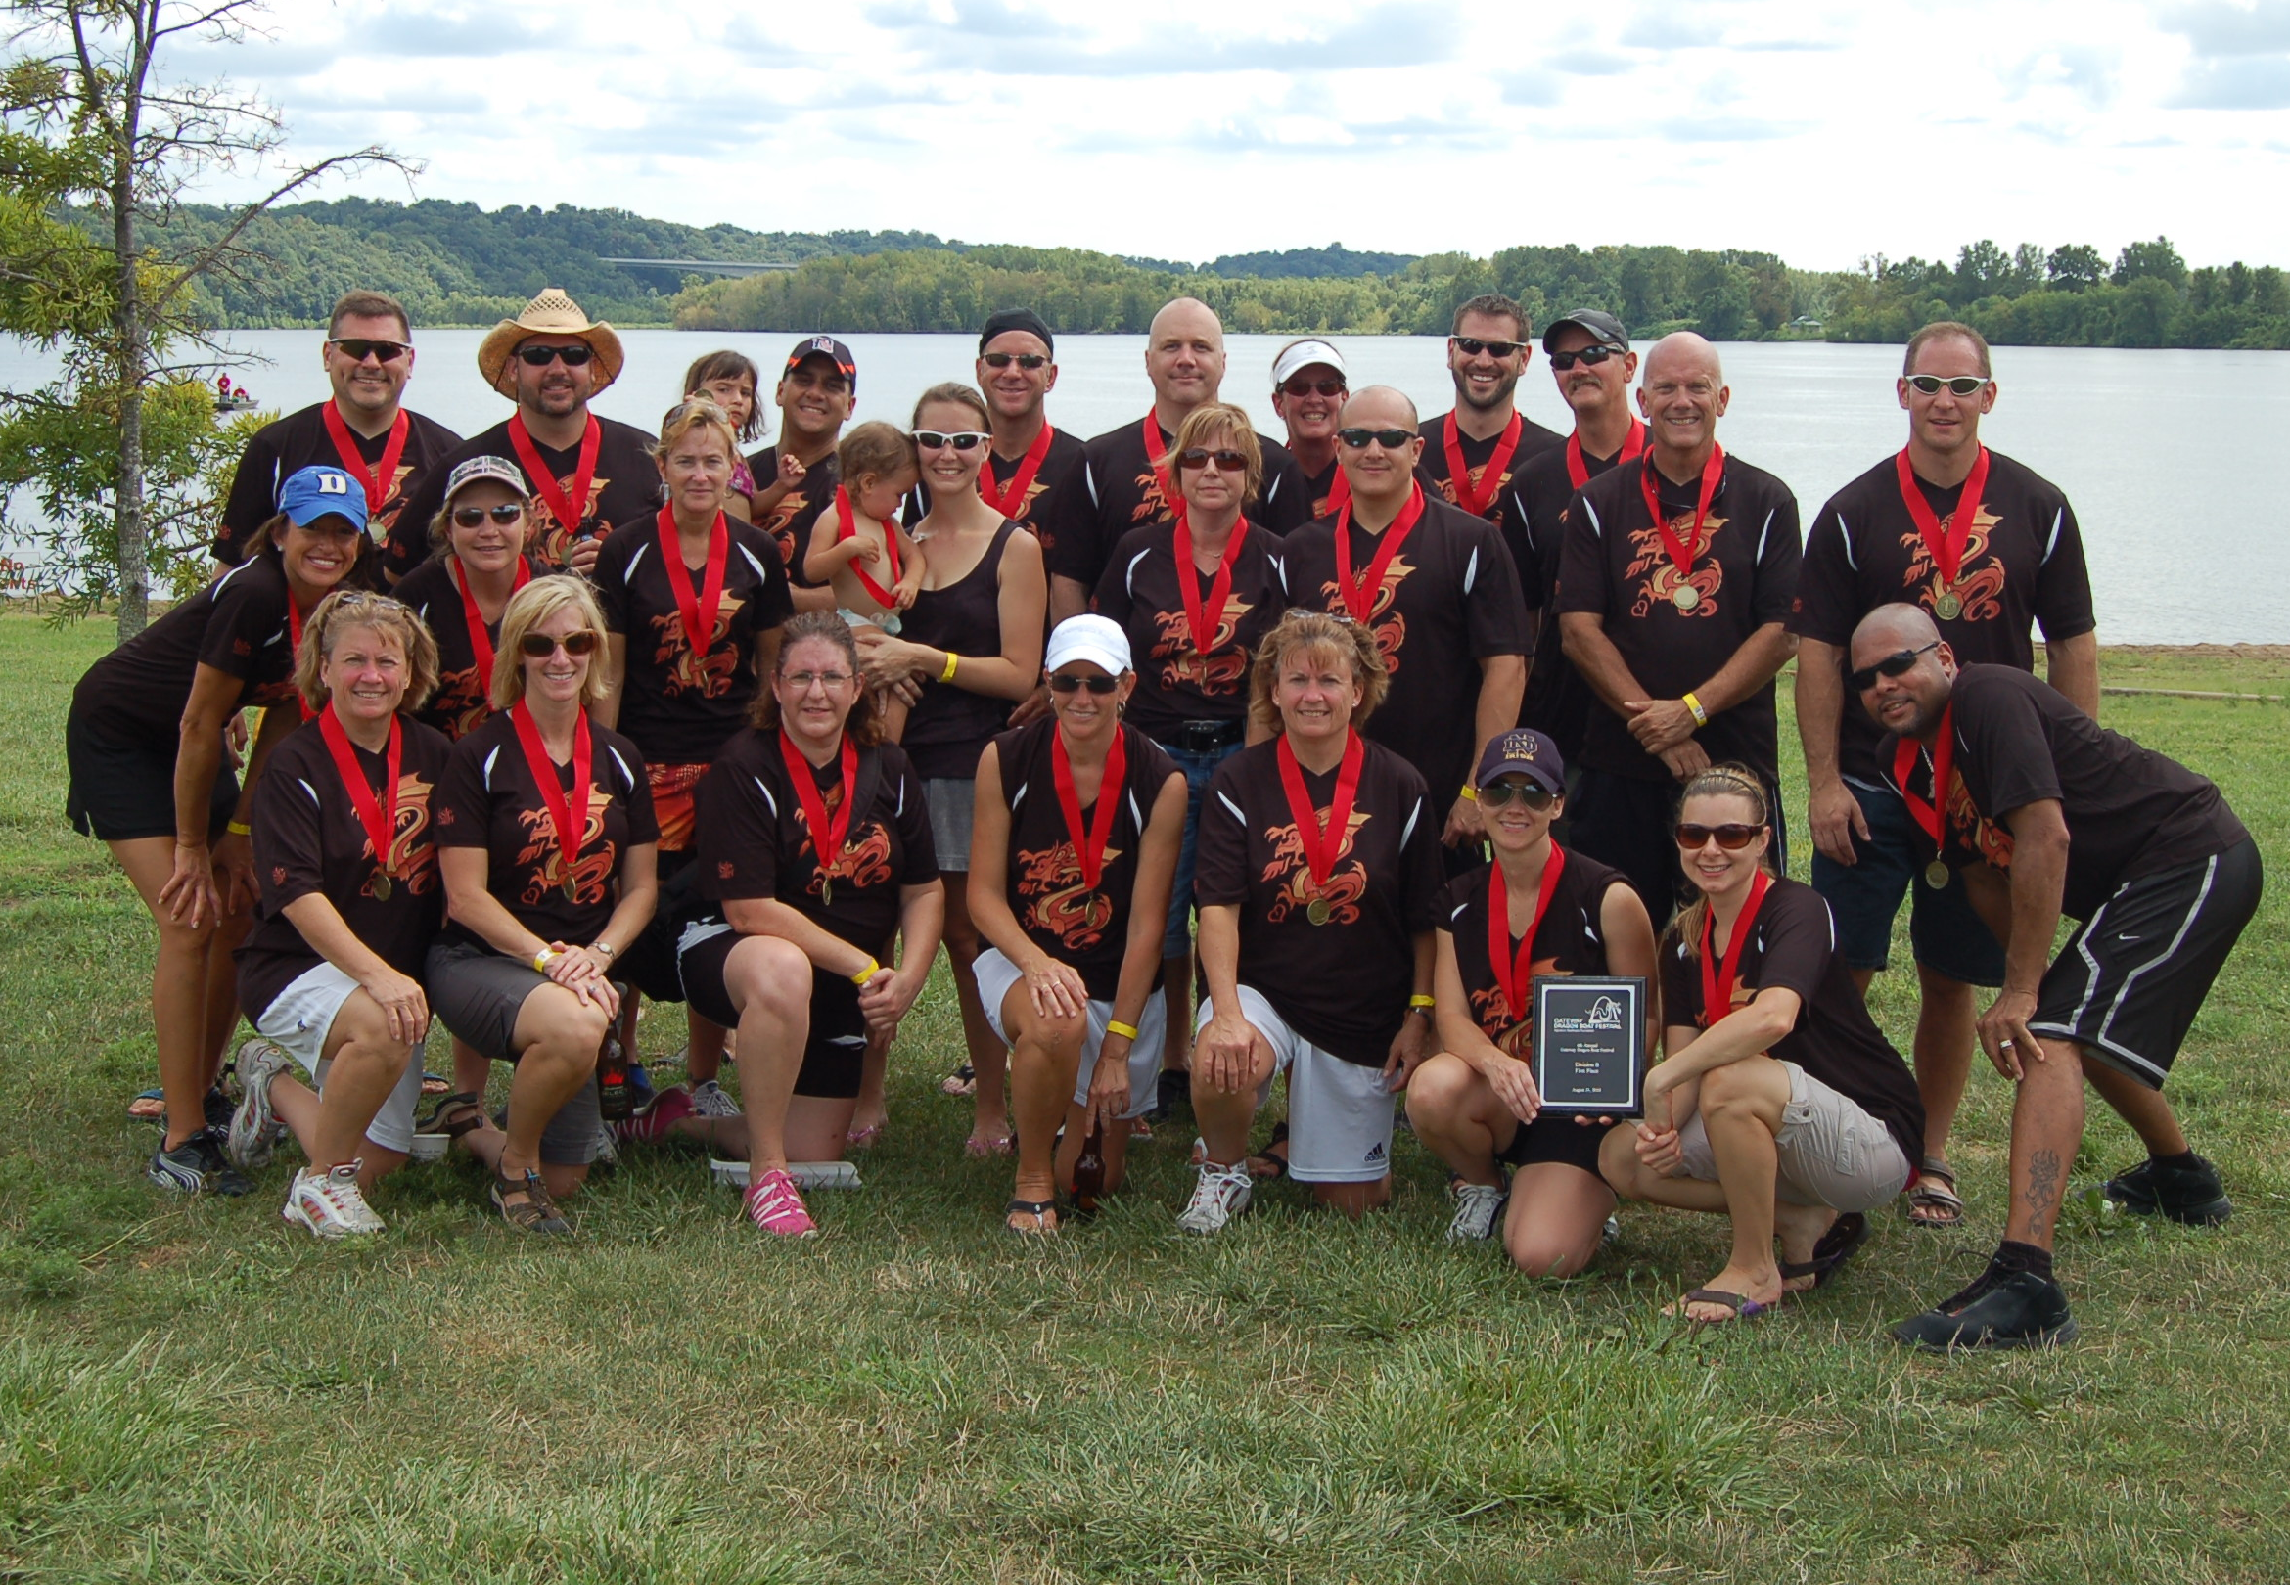
23

Slide 18
Utilization of MBE/WBE
Contractors
Isle is committed to utilizing minority and women-owned vendors
Existing Missouri Isle properties:
have recruited and encouraged the utilization of minority and women-owned businesses in their communities
continued to work with the Missouri Gaming Commission and John Nathan to increase utilization of MBE/WBE vendors

Slide 19
Focus on Responsible Gaming
Isle of Capri Casino is dedicated to identifying and assisting problem gamers and preventing underage gaming:
Active member of Missouri Alliance to Curb Problem Gambling through the Missouri Gaming Association
Adhere to the Code of Conduct of the American Gaming Association
Conduct annual training for compulsive and underage gaming for all team members
Promotion of Missouri DAP program and self-exclusion program, both of which will exclude impacted patrons from all Isle of Capri properties

Slide 20

Gaming Market Advisors
Steve Gallaway
Notes:
20

Slide 21
About GMA
Offices in Las Vegas and Denver
Domestic, International and Native American Markets in US and Canada
Have performed work in 16 countries for 6 public companies and numerous private gaming companies, financial institutions and Native American tribes

Slide 22








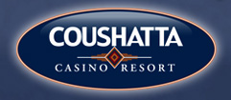


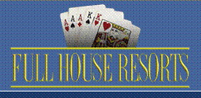






Recent Clients

Slide 23
About Gaming Market Advisors
Gaming Market Assessments
Hotel Feasibility Studies
Expansion/Relocation Analysis
Master Planning Recommendations
Marketing Plan Development
Business Plan Development
Player Rewards Program Design
Market Research
Operations & Financial Analysis
Marketing Audits
Notes:
Read slide first.
I had long been interested in the topic of player reinvestment analysis, dating back to my days at Alliance Gaming Corporation where I was involved in the design of a player reward programs. I was always interested in the public benefits that reward programs bestowed on their customers, the effects of point multiplier promotions and how they impacted profitability. What I saw as long as fifteen years ago was that casino marketers were not paying attention to the total cost of all of the cash, coupons, comps, merchandise, prizes & awards, special events and gifts that they were giving to their customers.
Over the years I developed an expertise in player reinvestment analysis, which is why I am here today. To share with you what I have learned over the years and to offer some tools to better analyze this thing we call “player reinvestment.’
23

Slide 24
Methodology
Numerous methods for projecting gaming revenues, but some are better than others
Basic Market Carve out Model
Concentric Ring Analysis
Benchmark Analysis
Gravity Model (considered most advanced)

Slide 25
Gravity Model Methodology (Cont.)
Is calibrated to current market conditions
Predictive model for future revenues based on nationally expected trends in population and income
Every casino in the market must be entered into the model.
Cannibalization is a simple matter of subtracting a “With Competition” scenario from the “Without Competition” scenario.

Slide 26
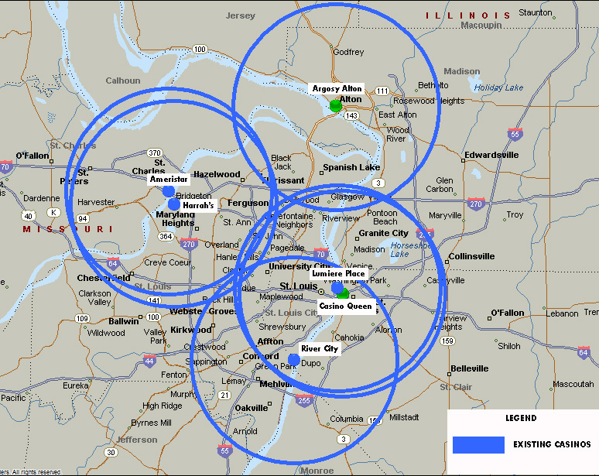
Saint Louis Existing Casinos
Rings
10 mile radius

Slide 27
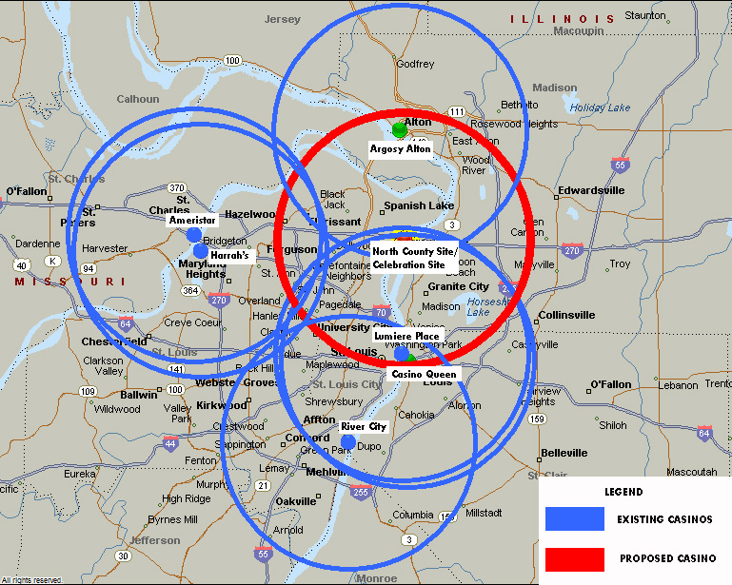
Saint Louis Proposed Casinos
Rings
10 mile radius

Slide 28
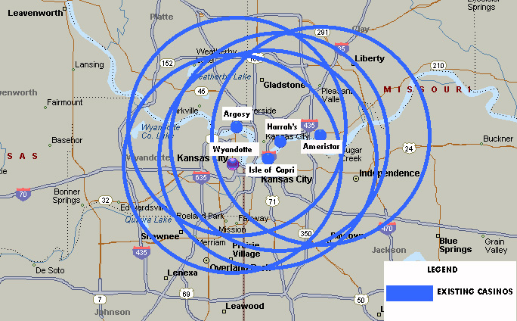
Kansas City Existing Casinos
Rings
10 mile radius

Slide 29
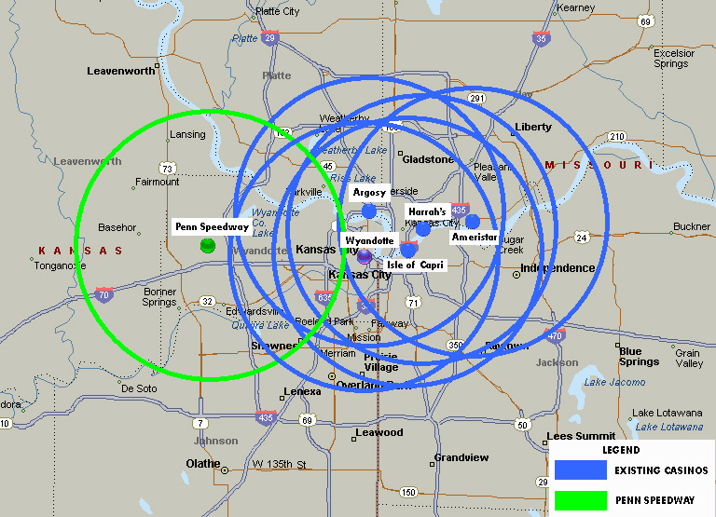
Kansas City with new Kansas Casino
Rings
10 mile radius

Slide 30
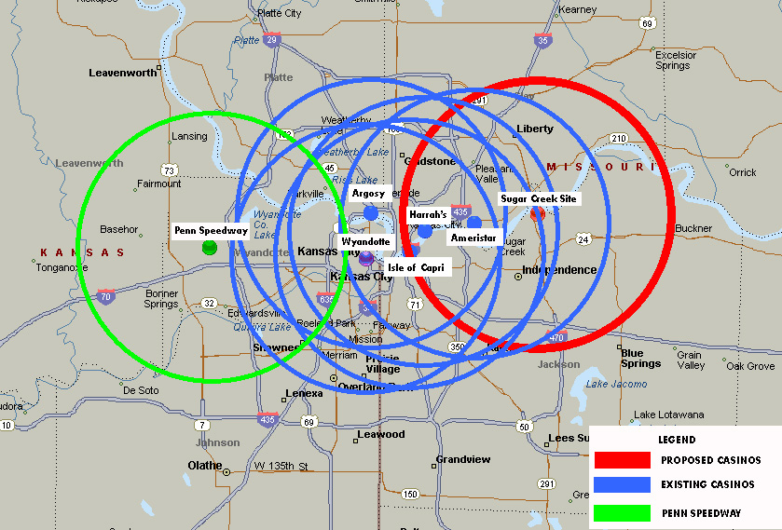
Kansas City Proposed Casino
Rings
10 mile radius

Slide 31
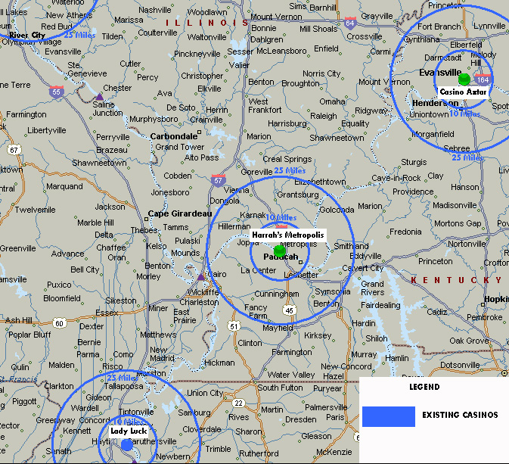
Cape Girardeau Existing Casinos
Illinois
Indiana
Cape
Missouri
Rings
10 mile radius
25 mile radius

Slide 32
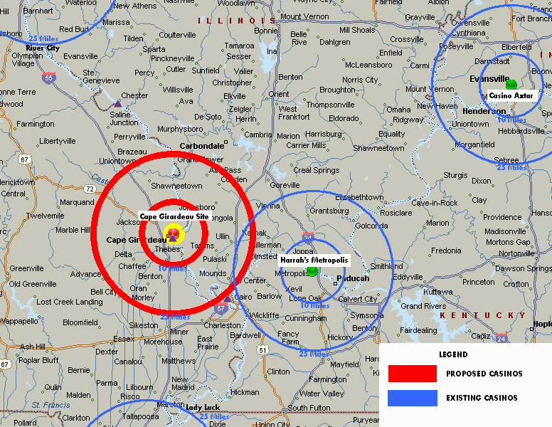
Cape Girardeau Proposed Casino
Rings
10 mile radius
25 mile radius

Slide 33
Results of Analysis: Casino Celebration - Chain of Rocks

Slide 35
Results of Analysis: North County

Slide 37
Results of Analysis: Paragon Casino – Sugar Creek

Slide 39
Results of Analysis: Cape Girardeau

Slide 41
Summary of Tax Impact

Slide 43
Gravity Model Conclusion
The Isle project in Cape Girardeau will produce nearly twice the incremental tax revenue for the state of Missouri as compared to the other applicants.

Slide 44
Saint Louis Experience

Slide 45
River City opens
* - River City Casino opened March 2010.

Slide 46
Revenue comes from existing properties

Slide 47
Missouri properties flat since River City opened

Slide 48
Kansas City Experience

Slide 49
Major expansion improves revenue

Slide 50
Revenue comes from existing properties

Slide 51
Kansas City market nearly flat

Slide 52
Summary
Greater Cape Girardeau market is not saturated
St. Louis and Kansas City are saturated markets
Kansas City will be further diluted when Penn National opens in Kansas
Best remaining market in Missouri is Cape Girardeau

Slide 53

Scott Meyer
City Manager, Cape Girardeau

Slide 54
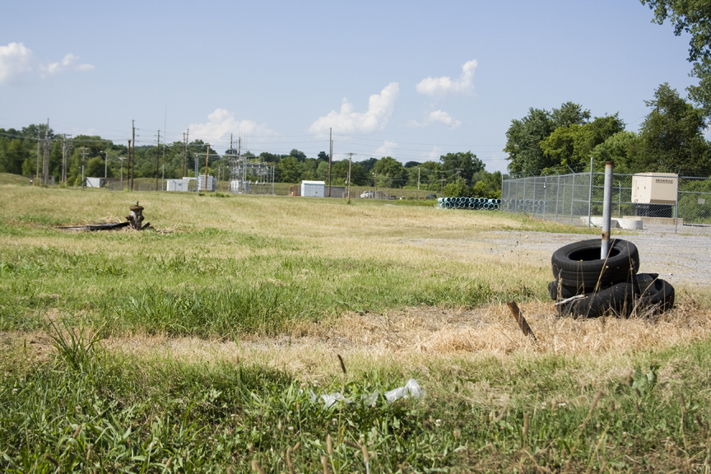
Existing conditions

Slide 55
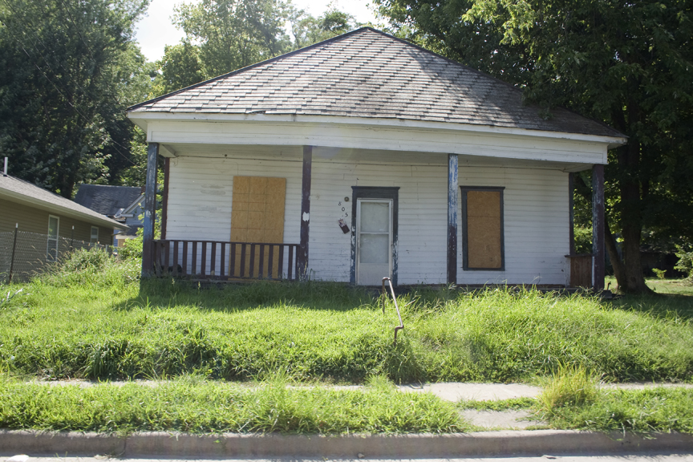

Slide 56
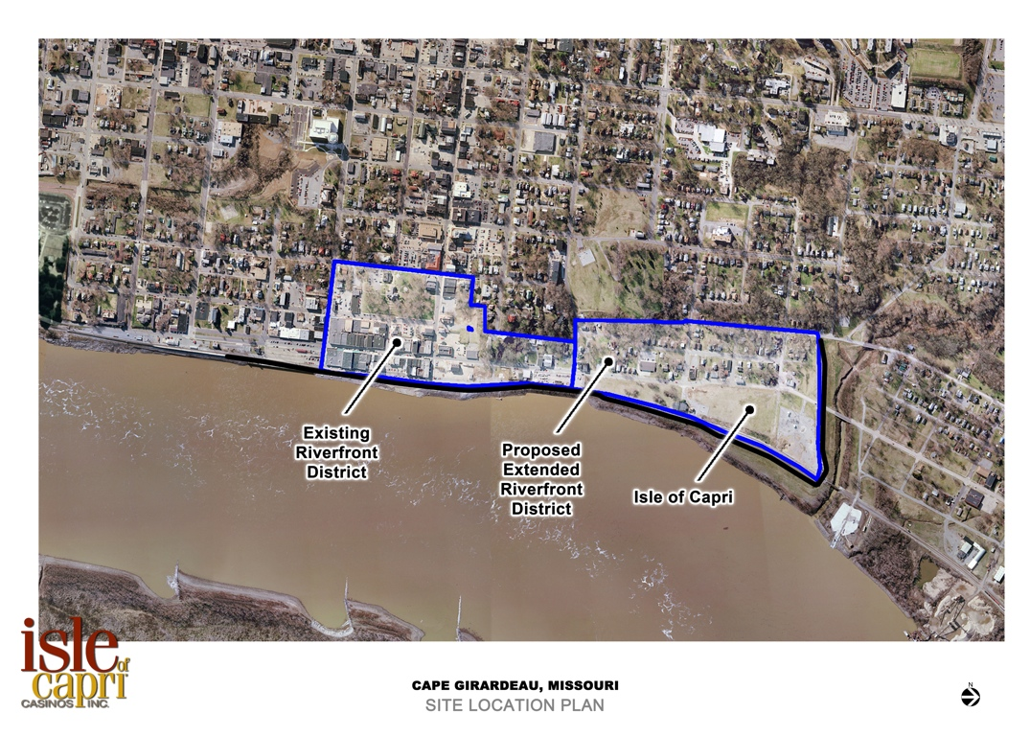
Isle of Capri site
Old Town Cape Historic District
31
56
This conceptual plan is for informational purposes only and is subject to revision.

Slide 57
Anchor for Downtown Revitalization
A former shoe factory site - inactive for 30+ years
Entirely protected by the levee
Excellent access to Downtown, the Show Me Center, and I-55. No significant traffic concerns
All infrastructure available on site
Police and Fire capabilities are sufficient
28

Slide 59
Richard Meister
Vice President, Design and Construction

Slide 60
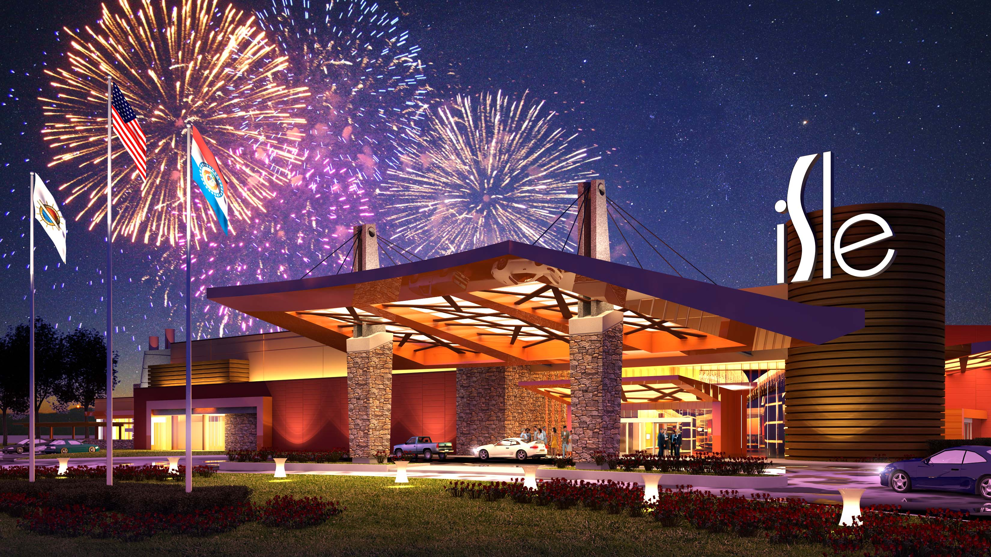
Isle at Cape Girardeau
Artist Rendering
52

Slide 61
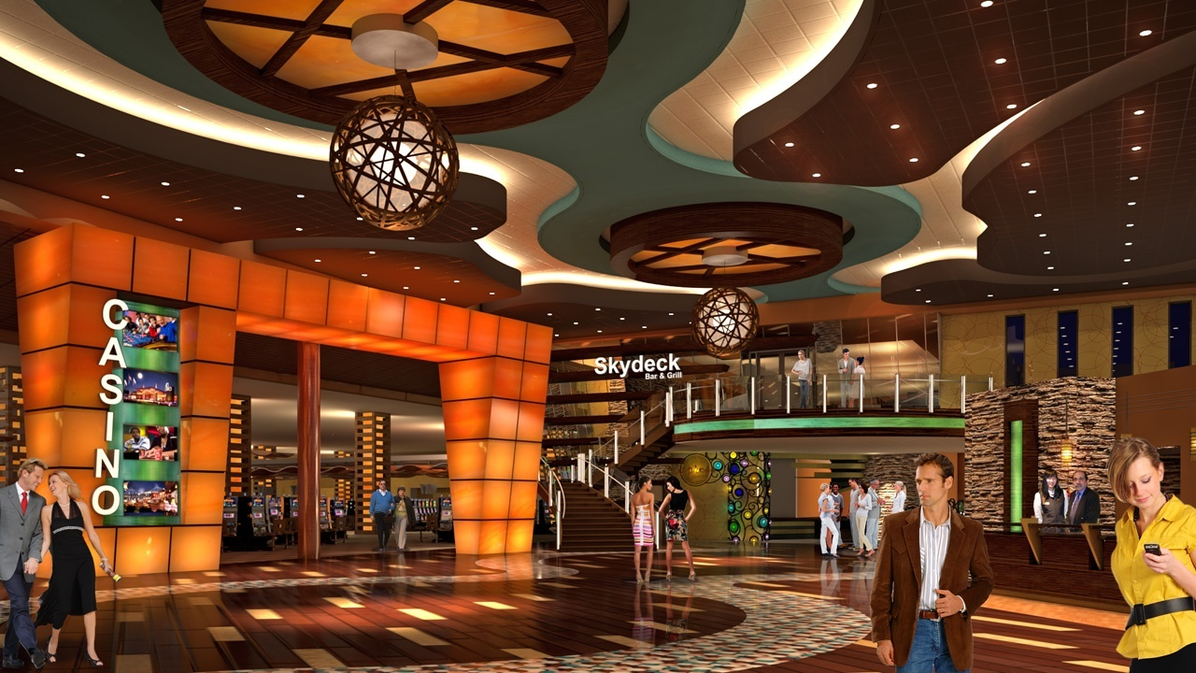
Promenade

Slide 62
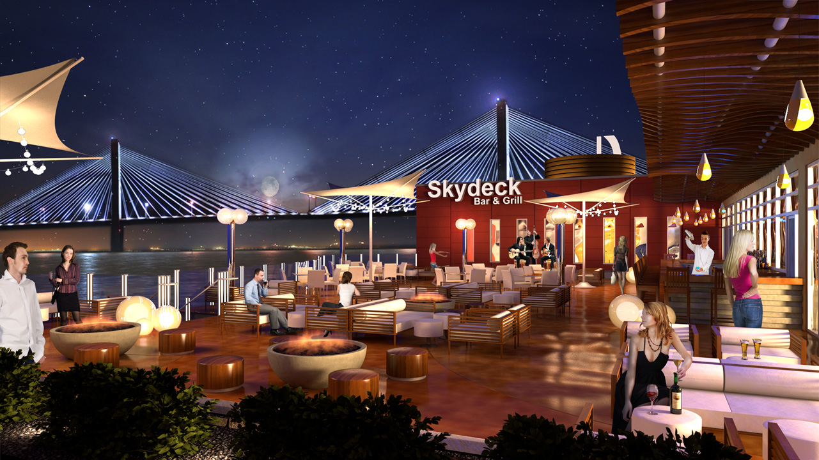
Skydeck Grill and Terrace

Slide 63
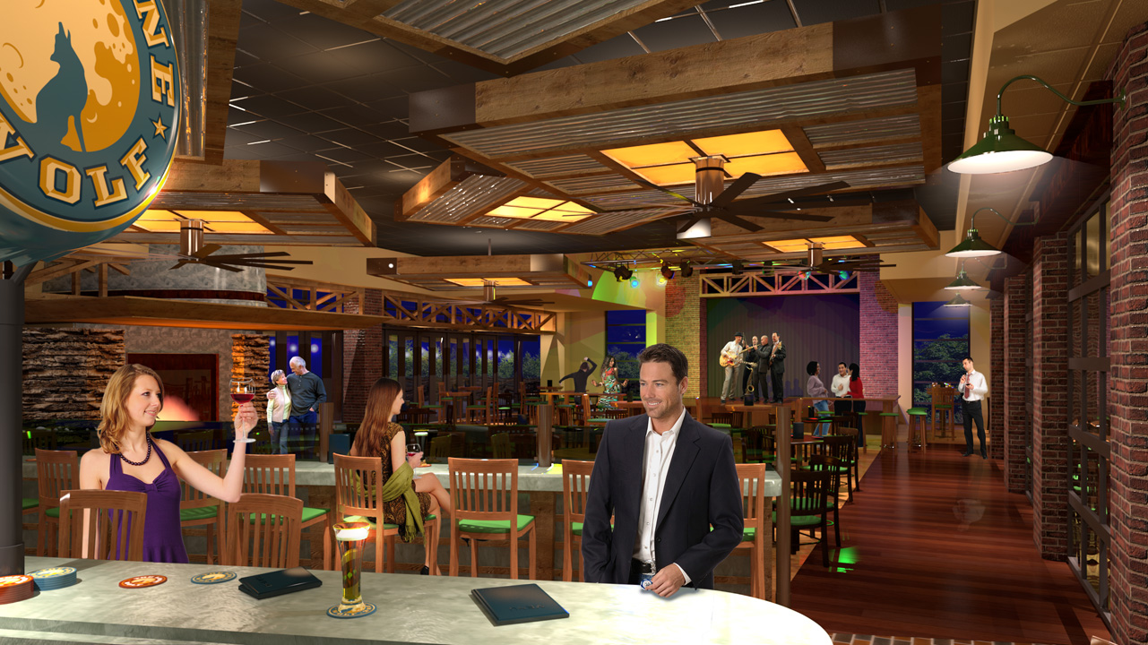
Lone Wolf Lounge

Slide 64
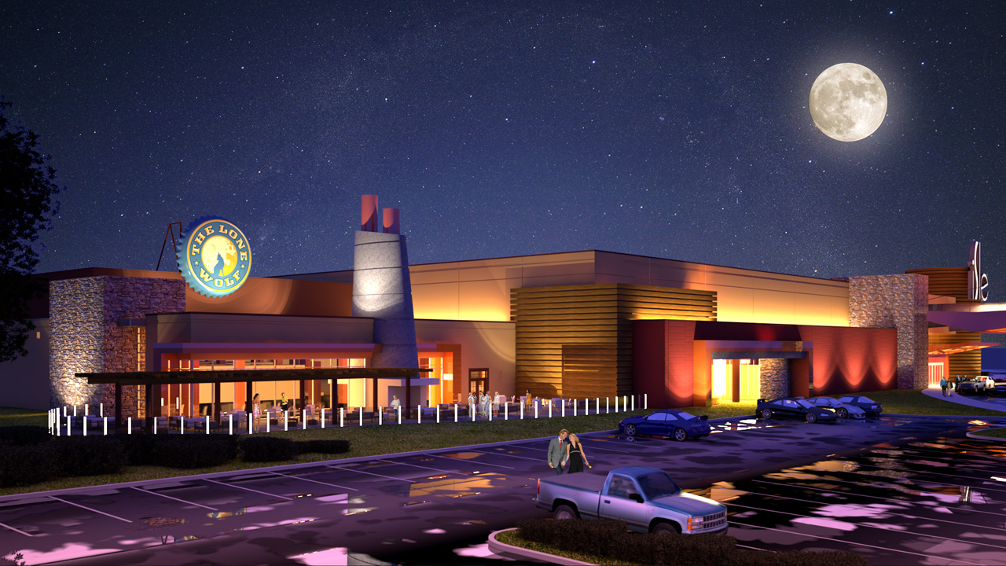
Lone Wolf and Outdoor Patio

Slide 65
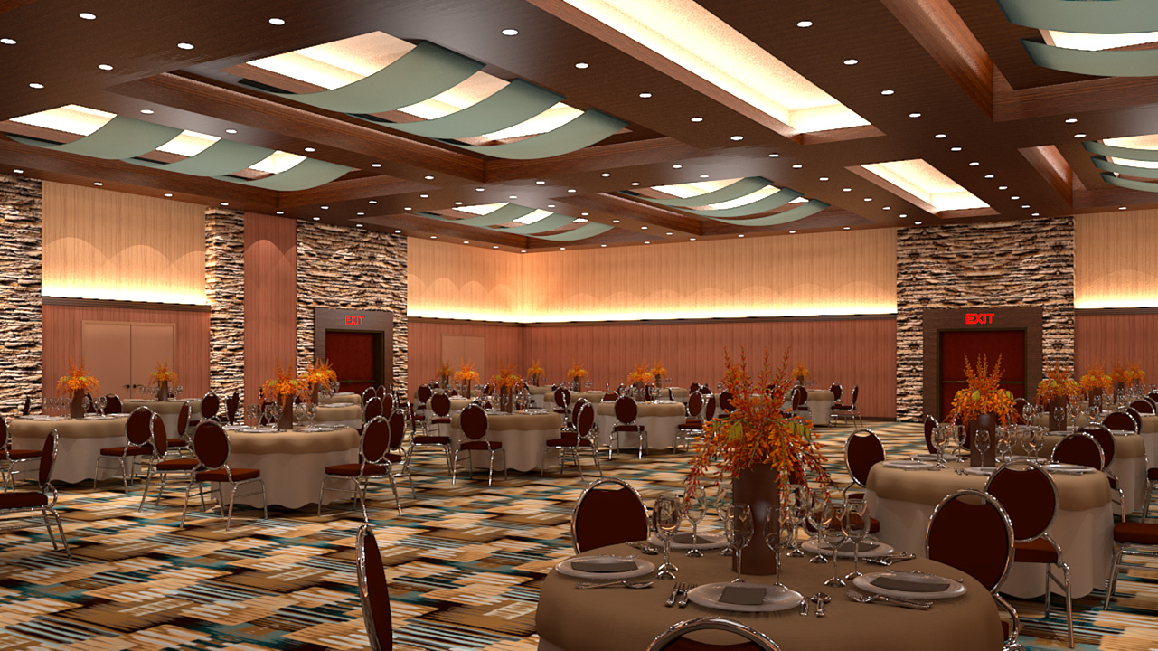
Event and Conference Center

Slide 66
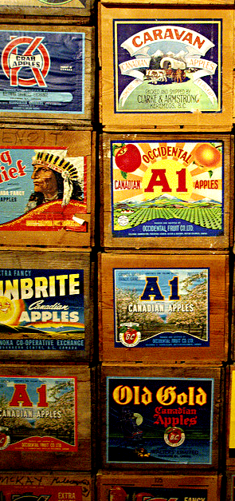


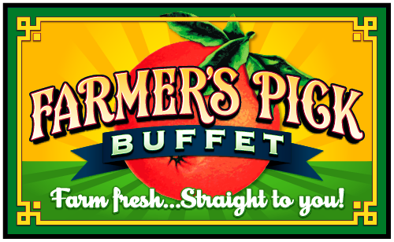

Farm fresh...
Straight to you.

Slide 67
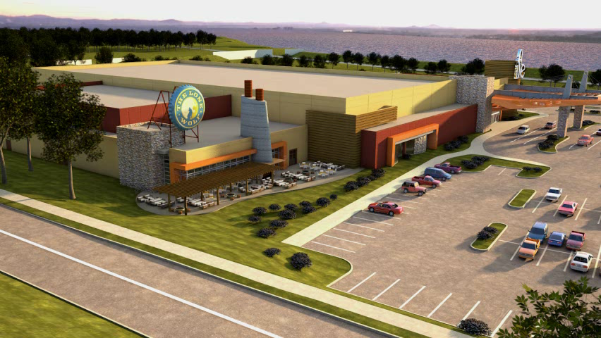

Slide 68
Paul Keller
Chief Development Officer

Slide 69


Our two brand strategy expands the customer base
with two products in the same family
Focus on close proximity patrons Focus on regional patrons
Limited amenities Expanded amenities
Product driven (gaming devices) Conference and experience driven

Slide 70
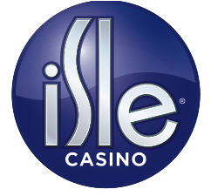

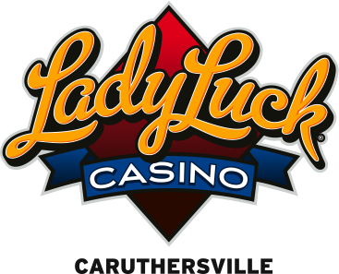

Slide 71
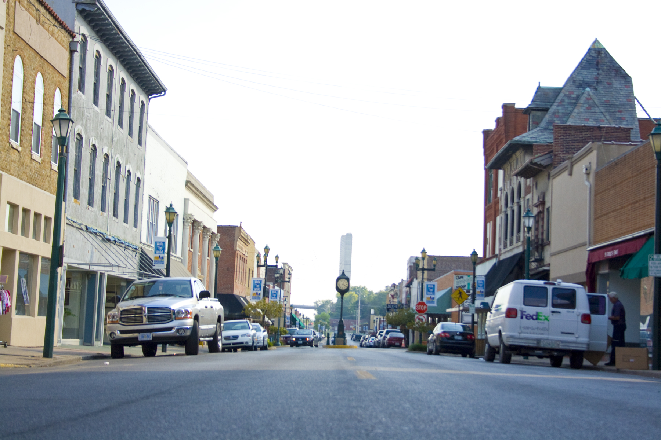
Creating another reason
for people to come
downtown

Slide 72
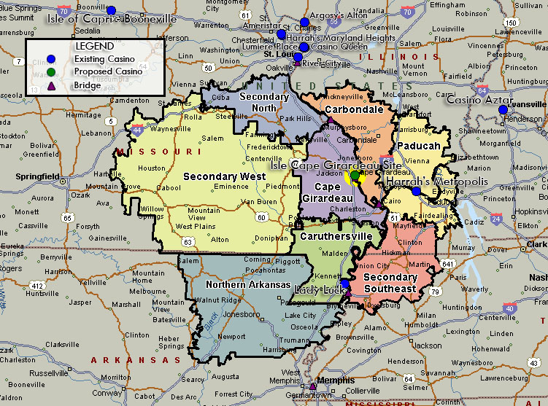
Regional Markets
33

Slide 73
600,000 visits will be from outside Cape/Jackson MSA
Markets will extend into in 6 States
1. northern Arkansas
2. southern Illinois
3. mid Missouri
4. western Tennessee
5. western Kentucky
6. southern Indiana

Slide 74
Significant increase in visits to downtown Cape Girardeau
Estimated weekly visitation: 25,000
Estimated new annual visits: Over 1,000,000
30

Slide 75
Proximity to other casinos
Harrah’s Metropolis, Illinois: 68 miles
Lady Luck Caruthersville: 85 miles
River City, St. Louis County: 109 miles
30

Slide 76
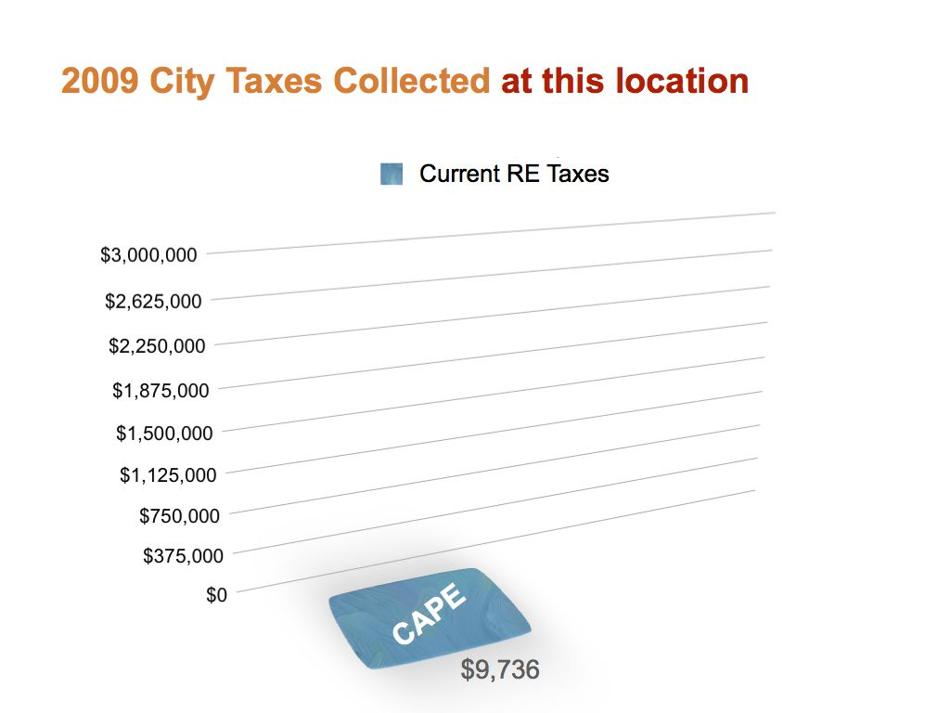

Slide 77
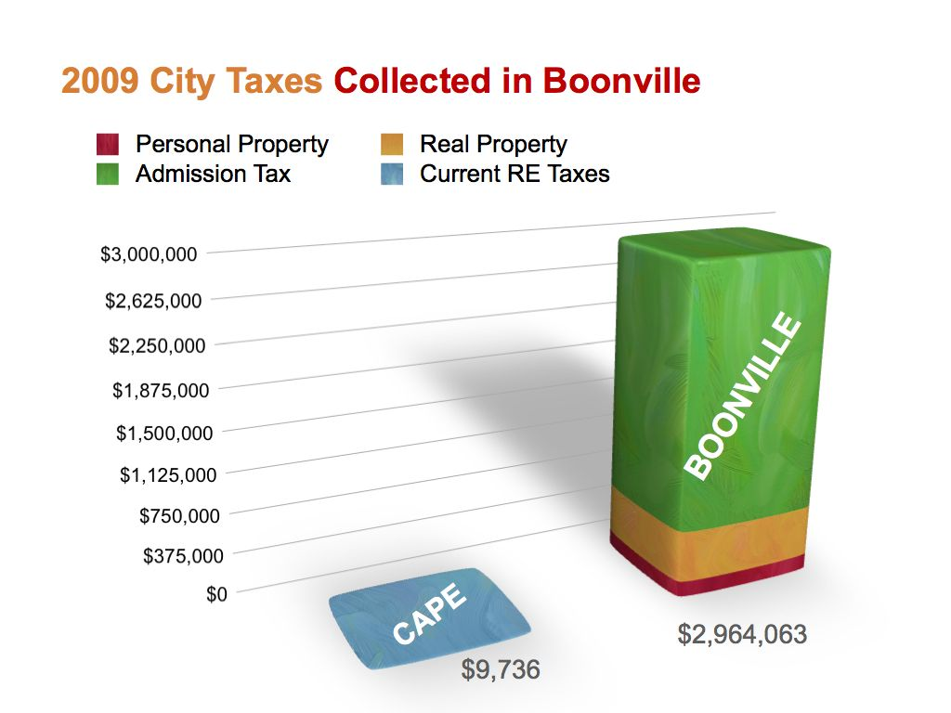
BOONVILLE
CAPE

Slide 78
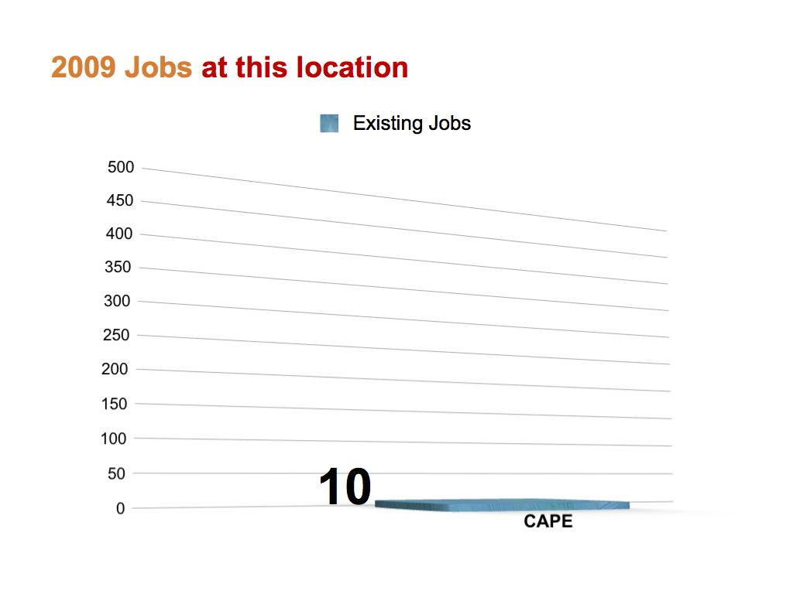

Slide 79
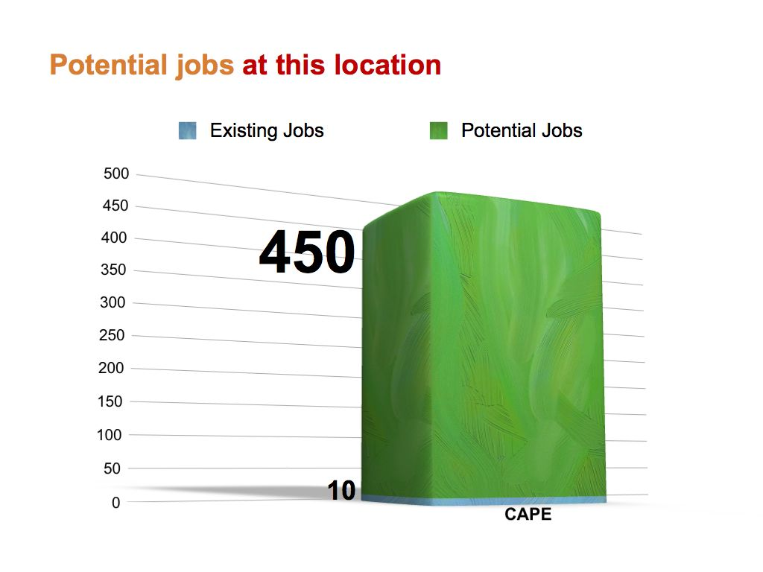

Slide 80
Dale Black
Chief Financial Officer

Slide 81
Financial Overview
Established public Company with proven track record of accessing multiple financial markets
Ability to use financing that is already in place
Many long term relationships with commercial banks and holders of public securities

Slide 82
Debt Holders
Institutions that are currently invested in debt instruments of Isle of Capri Casinos, Inc. include the following:

Slide 83
Equity Shareholders
The following are examples of Isle’s institutional shareholders:
Source: Institutional investment managers’ Form 13F dated June 30, 2010

Slide 84
Financing Options
Our existing credit facility, and our operating cash flows are sufficient to build this project
In addition, we have access to alternative debt sources should we choose to finance as a stand alone project

Slide 85
Harry Rediger
Mayor of Cape Girardeau

Slide 86
Endorsements
Cape Girardeau Chamber of Commerce
Cape Girardeau Area MAGNET
Old Town Cape, Inc.
IAFF 1084
Cape Girardeau Convention and Tourism Bureau
Drury Southwest, Inc.

Slide 87
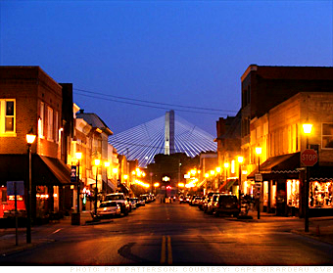
A Comprehensive Vision
Jobs.
Investment.
Revitalization.
27

Slide 88
5 Reasons Isle is Uniquely Qualified
1. Billion dollar revenue company with 15 properties
2. Already licensed in Missouri with 3 properties
3. Significant development experience
4. Best location to generate new Missouri tax revenue
5. Existing financial capability to build the project
48

Slide 89
Questions and Answers
34
This conceptual plan is for informational purposes only and is subject to revision.

Slide 90
Gravity Model Methodology
Based on Newton’s Universal Law of Gravitation
Distance= √ ((C lat – B lat)² + (C lon – B lon) ²)
The model calculates the likely visitation based on census and other factors after the model is calibrated to comparable facilities ?????

Slide 91
Gravity Model Methodology (Cont.)
Advantages of Gravity Model:
Market split into block groups or zip codes
Adjusts for population density and variations in income
Instead of less than 10 markets, usually have over 1,000
Main Inputs Include:
Propensity to gamble
% AAHI to Gaming
% Revenue to casino in market
Individual casino and market attraction factors

Slide 92
Missouri pro-forma economic concentration

Slide 93
Estimated Annual Missouri AGR (including Isle – Cape Girardeau)
Millions
Isle
Ameristar
Other
Pinnacle
Harrah’s

